Slide 1



Course: Image Processing 31651
Micro Project 2 (MP2) : Usage of Filtration
Date of submission :
1
Photo of the student | Shorten Name | ID (4 last digits)
 | shienfeld | 1950 | Student #1
 | pony | 2210 | Student #2
 | akimov | 7939 | Student #3

Slide 2
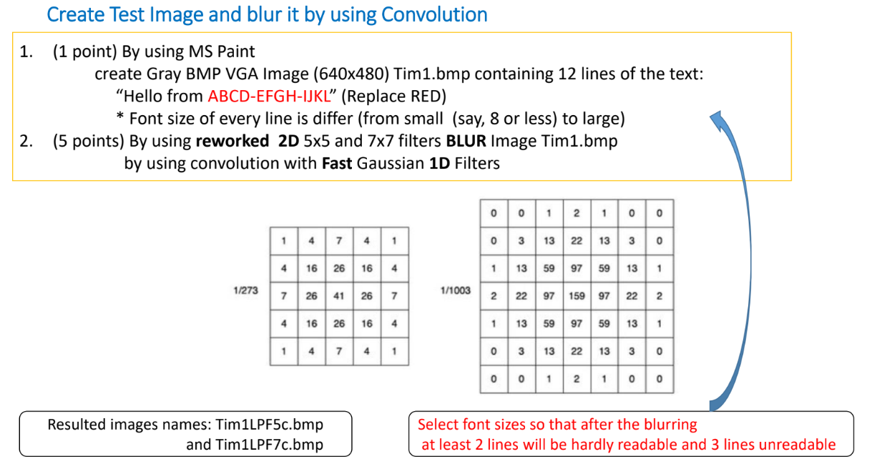
Micro Project 2 (MP2) : Usage of Filtration – the given task: (part 1)
2

Slide 3
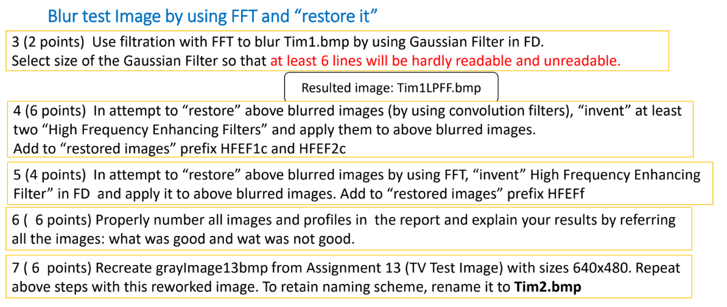
Micro Project 2 (MP2) : Usage of Filtration – the given task: (part 2)
3
Pay attention : that presentation is ordered in the following order : first introductory part where we present and explain the functions we used in the project – stand alone way (every function independently from the main flow) – and then the formal results for 1-7 sub tasks. They will be marked MP2.#

Slide 4
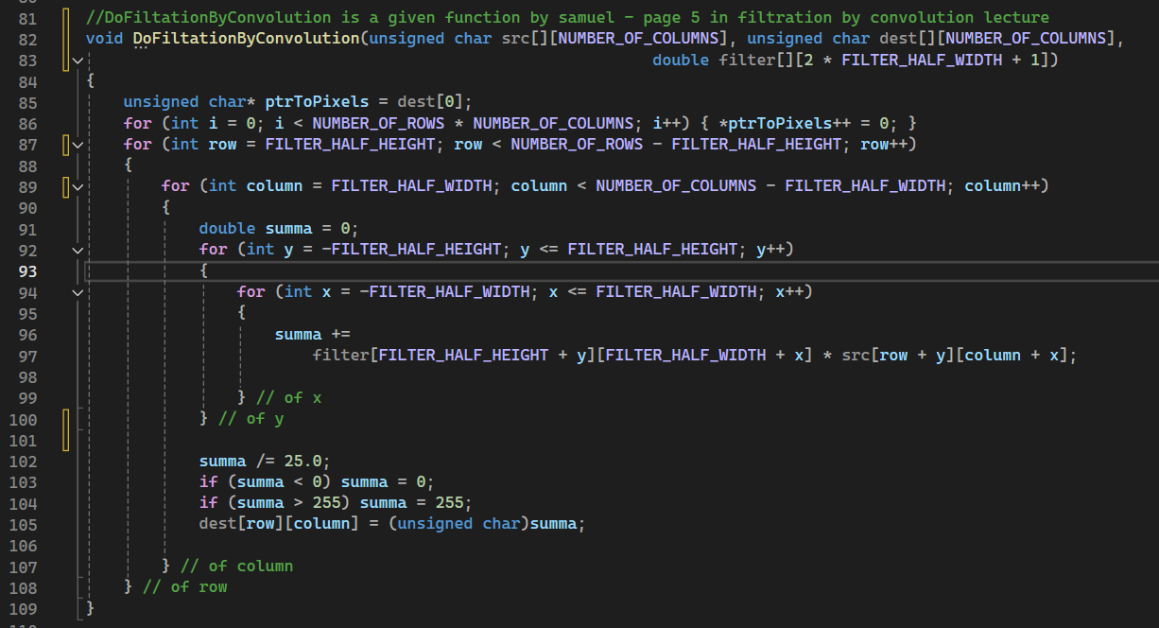
MP2.0 – introduction part 1.1 - the function “DoFiltationByConvolution”
4
That function applies a convolution operation between a given image (src) and a filter kernel (filter) to produce a filtered image (dest)
Due to the nature of the function (nested loops) we prefer to explain it step by step in a big space- hence the explanation will be in the next slide!

Slide 5
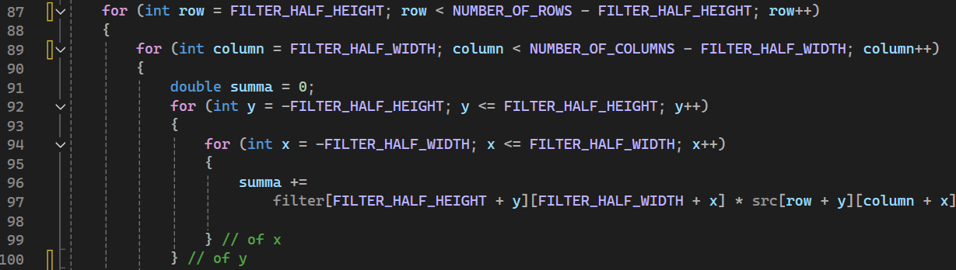
MP2.0 – introduction part 1.2 - the function “DoFiltationByConvolution”
5
First , defines a pointer to the first element of the dest array
Then the function sets all values in the dest array to zero to ensure that any previous data does not interfere with the current operation.
The function then iterates over each pixel in the src image, excluding the boundary pixels where the filter cannot be fully applied. This exclusion is due to the fact that convolution requires access to neighboring pixels, which are not available at the edges of the image.
For each pixel at position (row, column), the function calculates the convolution sum (summa) by multiplying each element of the filter kernel with the corresponding pixel in the src image. The sum is accumulated for the entire kernel.

Slide 6
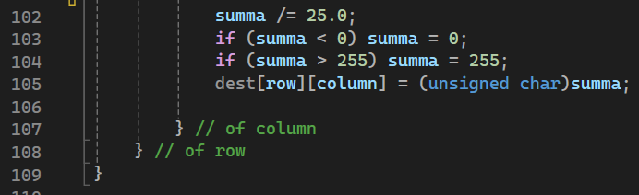
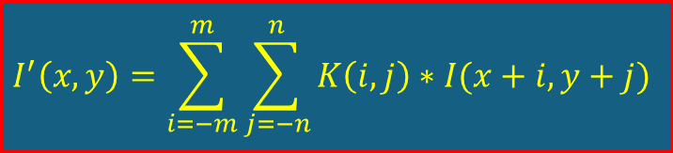
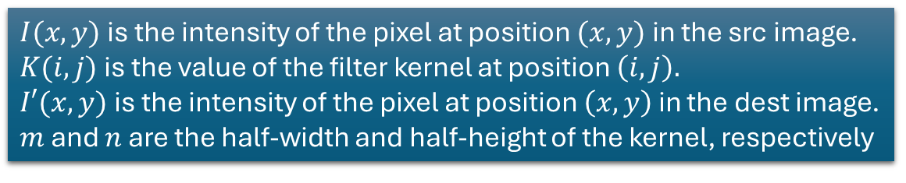
MP2.0 – introduction part 1.3 - the function “DoFiltationByConvolution”
6
After computing the sum, the result is normalized by dividing by 25.0, which corresponds to the total number of elements in the 5x5 filter (this is specific to the filter being used; other filters might have different normalization factors).
The resulting value is then clamped to the valid grayscale range [0, 255] to ensure that the pixel intensity remains within the allowable range.
The normalized and clamped sum is then cast to an unsigned char and stored in the dest array at the corresponding pixel position.
Short remainder of 2D convolution:
$I(x,y)$is the intensity of the pixel at position $(x,y)$in the src image.
$K(i,j)$is the value of the filter kernel at position $\left(i,j\right).$
$I′(x,y)$is the intensity of the pixel at position $\left(x,y\right)$ in the dest image.
$m$ and $n$ are the half-width and half-height of the kernel, respectively
$$I^{′}\left(x,y\right)=\sum_{i=−m}^{m}{\sum_{j=−n}^{n}{K\left(i,j\right)∗I(x+i,y+j)}}$$
The 2D convolution is a dimensional expansion to the well known 1D convolution as we studies in digital signal processing Couse

Slide 7
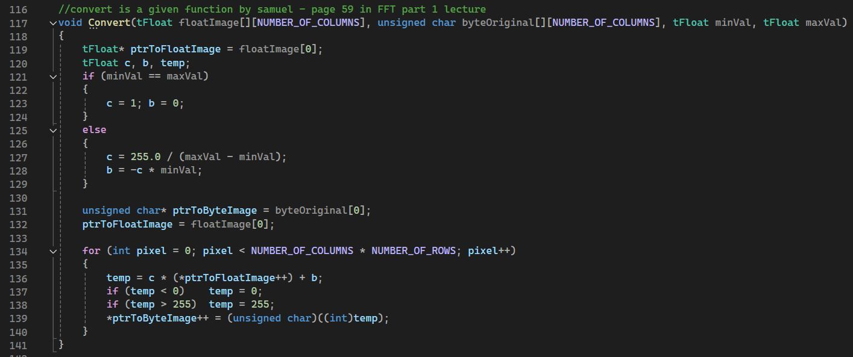
MP2.0 – introduction part 2 - the function “Convert”
7

Slide 8
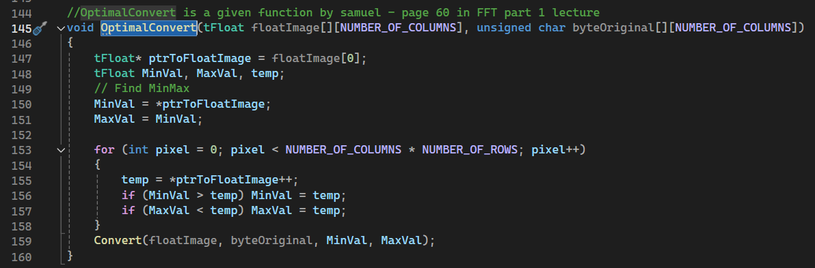
MP2.0 – introduction part 3 - the function “OptimalConvert”
8

Slide 9
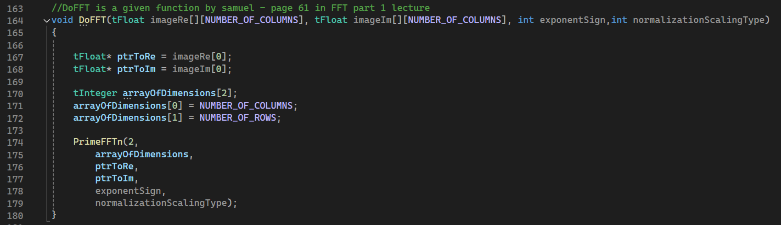
MP2.0 – introduction part 4 - the function “DoFFT”
9

Slide 10
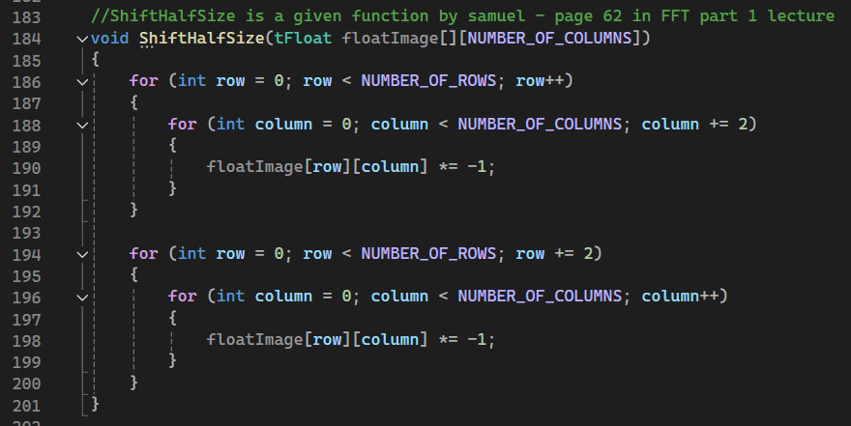
MP2.0 – introduction part 5 - the function “ShiftHalfSize”
10

Slide 11
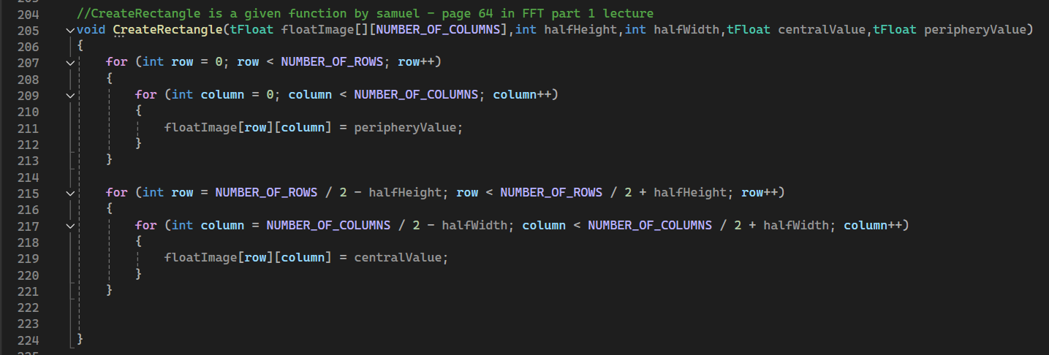
MP2.0 – introduction part 6 - the function “CreateRectangle”
11

Slide 12
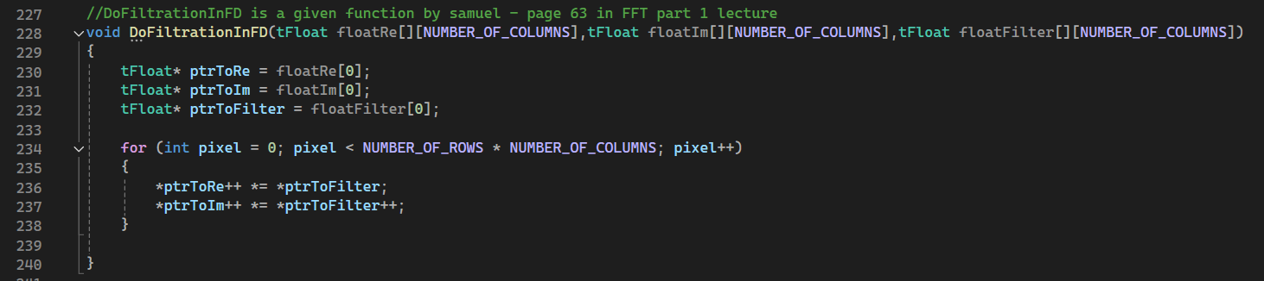
MP2.0 – introduction part 7 - the function “DoFiltrationInFD”
12

Slide 13
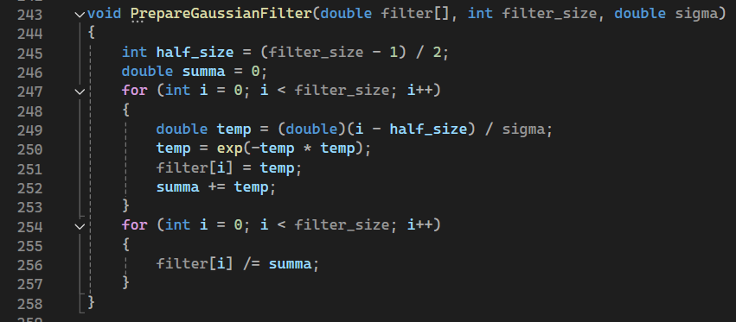
MP2.0 – introduction part 8 - the function “PrepareGaussianFilter”
13

Slide 14
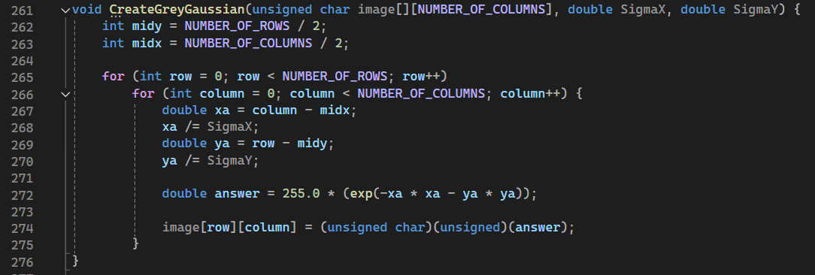
MP2.0 – introduction part 9 - the function “CreateGreyGaussian”
14

Slide 15
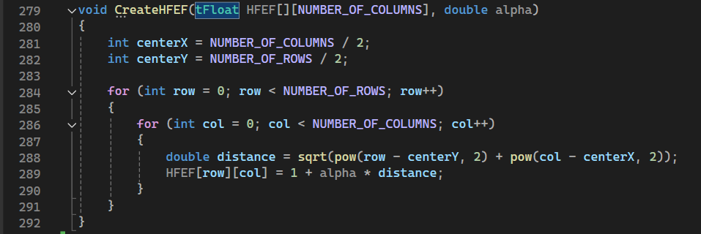
MP2.0 – introduction part 10 - the function “CreateHFEF”
15

Slide 16
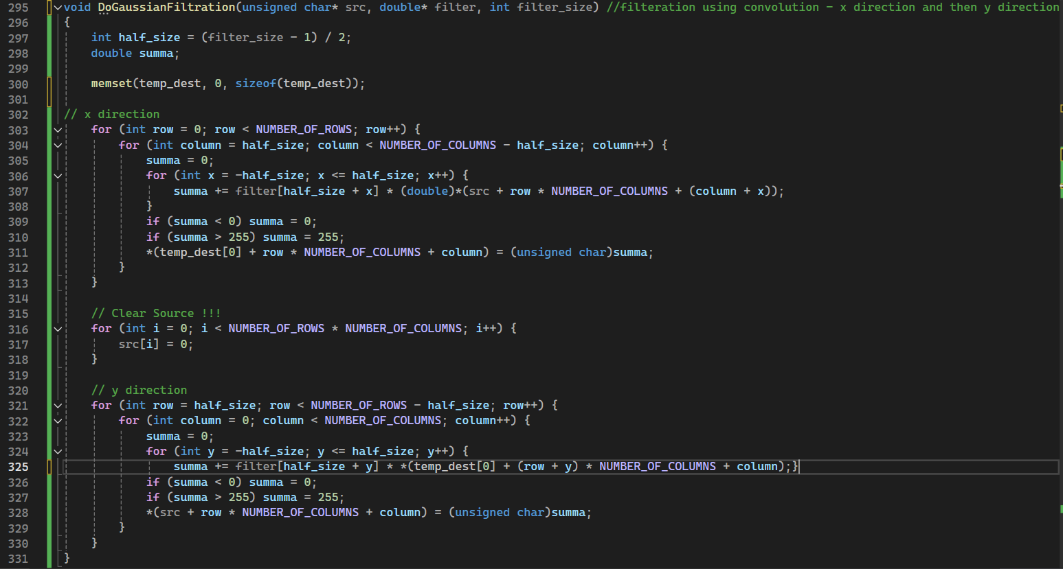
MP2.0 – introduction part 11 - the function “DoGaussianFiltration”
16

Slide 17
MP2.0 – introduction part 12 - the function “main”
17

Slide 18
MP2.0 – introduction part 12 - the function “main”
18

Slide 19
MP2.0 – introduction part 13 - the function “work”
19

Slide 20
MP2.1 – the function “DoFiltationByConvolution”
20

Slide 21
MP2.1 – the function “DoFiltationByConvolution”
21

Slide 22
MP2.1 – the function “DoFiltationByConvolution”
22

Slide 23
MP2.1 – the function “DoFiltationByConvolution”
23

Slide 24
MP2.1 – the function “DoFiltationByConvolution”
24

Slide 25
MP2.1 – the function “DoFiltationByConvolution”
25

Slide 26
MP2.1 – the function “DoFiltationByConvolution”
26

Slide 27
MP2.1 – the function “DoFiltationByConvolution”
27

Slide 28
MP2.1 – the function “DoFiltationByConvolution”
28

Slide 29
MP2.1 – the function “DoFiltationByConvolution”
29

Slide 30
MP2.1 – the function “DoFiltationByConvolution”
30

Slide 31
MP2.1 – the function “DoFiltationByConvolution”
31

Slide 32
MP2.1 – the function “DoFiltationByConvolution”
32

Slide 33
MP2.1 – the function “DoFiltationByConvolution”
33

